Slide 1

Micro Processors & Interfacing
16CS307
Unit- 5
Lec-3 :
Interfacing of 8051
Mr. M Krishna Chennakesava Rao,
Asst. Professor, Dept. of ECE,
VFSTR University

Slide 2
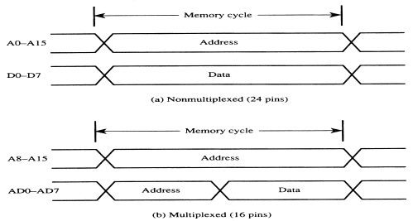
Address Multiplexing for External Memory
5.2 External Memory interfacing with 8051
Figure 5.2.1
Multiplexing the address (low-byte) and data bus

Slide 3
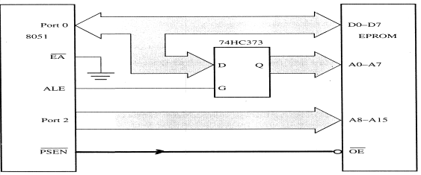
Address Multiplexing for External Program Memory
Figure : Accessing external code memory

Slide 4
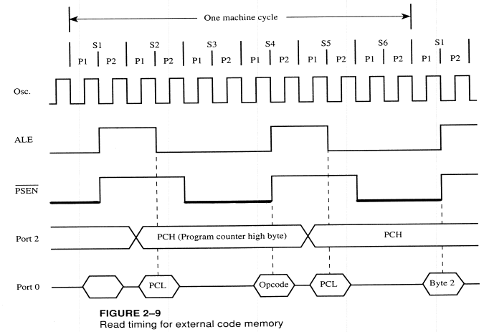

Slide 5
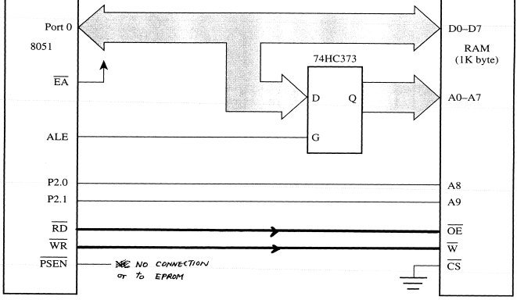
Accessing External Data Memory
Figure 2-11
Interface to 1K RAM

Slide 6
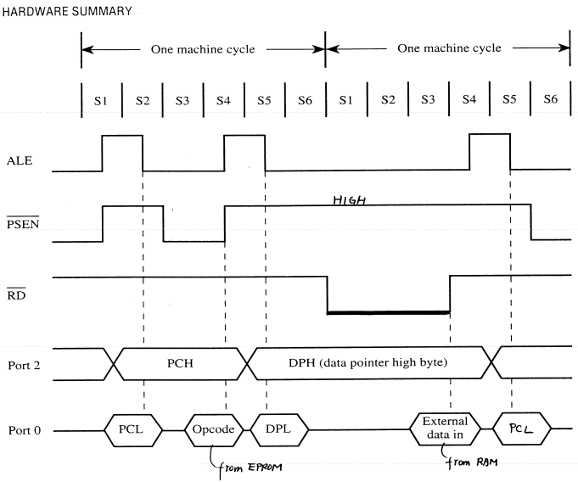
Timing for MOVX instruction

Slide 7
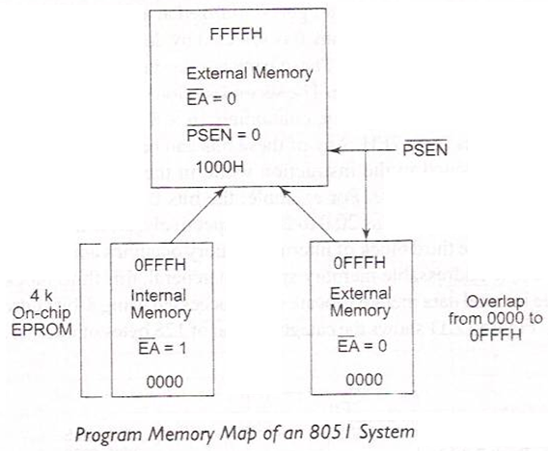
8051- Architecture cont’d…
ROM Organization: -
DPTR is used to access external data memory (External RAM)
is used to access external program memory (External ROM)

Slide 8
External code memory
WR
RD
PSEN
OE
ALE
74LS373
CS
G
P0.0
P0.7
A0
A7
D
D0
D7
EA
P2.0
P2.7
A8
A15
8051
ROM

Slide 9
External data memory
WR
WR
RD
RD
PSEN
ALE
74LS373
CS
G
P0.0
P0.7
A0
A7
D
D0
D7
EA
P2.0
P2.7
A8
A15
8051
RAM

Slide 10
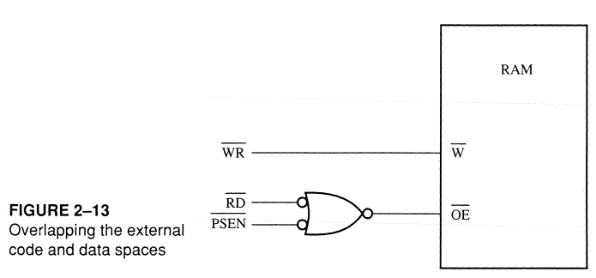
Overlapping External Code and Data Spaces
AND
GATE

Slide 11
Overlapping External Code and Data Spaces
WR
WR
RD
PSEN
RD
ALE
74LS373
CS
G
P0.0
P0.7
A0
A7
D
D0
D7
EA
P2.0
P2.7
A8
A15
8051
RAM

Slide 12
Overlapping External Code and Data Spaces
Allows the RAM to be
written as data memory, and
read as data memory as well as code memory.
This allows a program to be
downloaded from outside into the RAM as data, and
executed from RAM as code.

Slide 13
5.2 External Memory interfacing with 8051 cont’d…
Chip capacity: number of bits that a semiconductor memory chip can store.
It can be in units of Kbits (kilobits), Mbits (megabits), and so on....
A memory chip contain 2^{X} location, where x is the number of address pins.
Each location contains Y bits, where y is the number of data pins on the chip.
The entire chip will contain 2^{X} × Y bits.

Slide 14
5.2 External Memory interfacing with 8051 cont’d…
Example : 1
A given memory chip has 12 address pins and 4 data pins.
Find: (a) The organization, and (b) the capacity.
Solution:
This memory chip has 4096 locations (2¹² = 4096),
and each location can hold 4 bits of data.
This gives an organization of 4096 × 4, often represented as 4K × 4.
(b) The capacity is equal to 16K bits since there is a total of 4K locations
and each location can hold 4 bits of data.

Slide 15
5.2 External Memory interfacing with 8051 cont’d…
Example 2 :
A 512K memory chip has 8 pins for data. Find:
The organization, and
The number of address pins for this memory chip.
Solution:
(a) A memory chip with 8 data pins means that each location within the chip can hold 8 bits of data.
To find the number of locations within this memory chip, divide the capacity by the number of data pins. 512K/8 = 64K;
therefore, the organization for this memory chip is 64K × 8
(b) The chip has 16 address lines since 2¹⁶ = 64K

Slide 16
8051 Connection to External Data ROM

Slide 17
5.2 External Memory interfacing with 8051 cont’d…

Slide 18
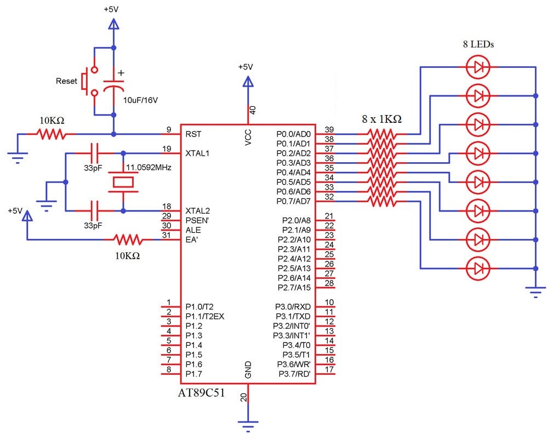
Interfacing of 8051 with LED

Slide 19
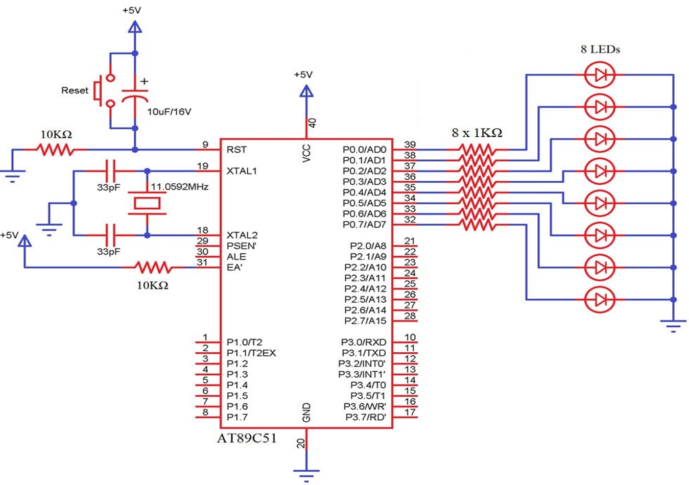
Project 1: Interfacing of 8051 with LED
Program:
mov a, #01h
up: mov p0, a
acall delay
rl a
sjmp up
delay: mov r0, #80h
l3: mov r1, #0ffh
l2: mov r2, #0ffh
l1: djnz r2, l1
djnz r1, l2
djnz r0, l3
ret
end
LED 1 | LED 2 | LED 3 | LED 4 | LED 5 | LED 6 | LED 7 | LED 8
0 | 0 | 0 | 0 | 0 | 0 | 0 | 1
0 | 0 | 0 | 0 | 0 | 0 | 1 | 0
0 | 0 | 0 | 0 | 0 | 1 | 0 | 0
0 | 0 | 0 | 0 | 1 | 0 | 0 | 0
0 | 0 | 0 | 1 | 0 | 0 | 0 | 0
0 | 0 | 1 | 0 | 0 | 0 | 0 | 0
0 | 1 | 0 | 0 | 0 | 0 | 0 | 0
1 | 0 | 0 | 0 | 0 | 0 | 0 | 0

Slide 20
Project 2 : Interfacing of 8051 with LED
Program:
up: mov a, #55h
mov p0, a
acall delay
mov a, #0aah
mov p0,a
acall delay
sjmp up
delay: mov r0, #80h
l3: mov r1, #0ffh
l2: mov r2, #0ffh
l1: djnz r2, l1
djnz r1, l2
djnz r0, l3
ret
end
LED 1 | LED 2 | LED 3 | LED 4 | LED 5 | LED 6 | LED 7 | LED 8
0 | 1 | 0 | 1 | 0 | 1 | 0 | 1 | 55 h
1 | 0 | 1 | 0 | 1 | 0 | 1 | 0 | aa h

Slide 21
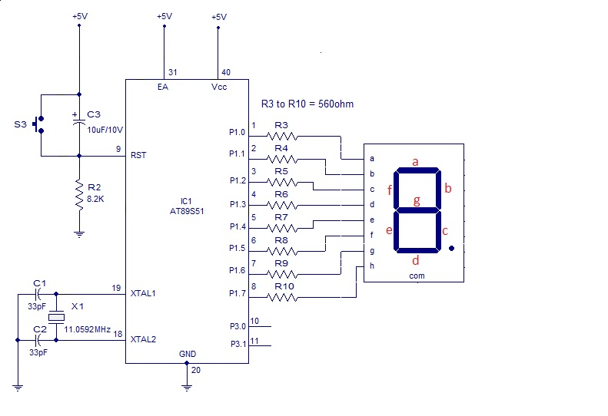
Project 3:Interfacing of 8051 with Seven Segment Display

Slide 22
Project 3:Interfacing of 8051 with Seven Segment Display cont’d…
 | P.7 | P.6 | P.5 | P.4 | P.3 | P.2 | P.1 | P.0
Decimal Symbol | a | b | c | d | e | f | g | P0.0 | Hexadecimal
0 | 1 | 1 | 1 | 1 | 1 | 1 | 0 | 0 | FC
1 | 0 | 1 | 1 | 0 | 0 | 0 | 0 | 0 | 60
2 | 1 | 1 | 0 | 1 | 1 | 0 | 1 | 0 | DA
3 | 1 | 1 | 1 | 1 | 0 | 0 | 1 | 0 | F2
4 | 0 | 1 | 1 | 0 | 0 | 1 | 1 | 0 | 66
5 | 1 | 0 | 1 | 1 | 0 | 1 | 1 | 0 | B6
6 | 1 | 0 | 1 | 1 | 1 | 1 | 1 | 0 | BE
7 | 1 | 1 | 1 | 0 |  |  |  | 0 | E0
8 | 1 | 1 | 1 | 1 | 1 | 1 | 1 | 0 | FE
9 | 1 | 1 | 1 | 1 | 0 | 1 | 1 | 0 | F6

Slide 23
Project 3:Interfacing of 8051 with Seven Segment Display cont’d…
up1: mov dptr, #Table
mov r1, #0ah ; 10 numbers (0-9) are to be displayed
mov a, #00h
up: movc a, @a+dptr
mov p0, a
acall delay
inc dptr
djnz r1, up
sjmp up1
delay: mov r0, #80h
l3: mov r1, #0ffh
l2: mov r2, #0ffh
l1: djnz r2, l1
djnz r1, l2
djnz r0, l3
ret
end
Table: db 0fch,60h,0dah,0f2h,66h,0b6h,0beh,0e0h,0feh,0f6h
end
Look Up Table
Decimal Symbol | Hexa decimal
0 | FC
1 | 60
2 | DA
3 | F2
4 | 66
5 | B6
6 | BE
7 | E0
8 | FE
9 | F6

Slide 24
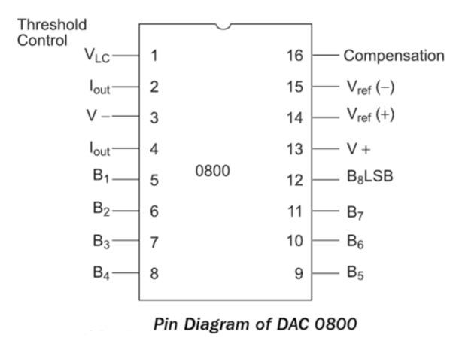
Project 4:Interfacing of 8051 with DAC
Digital-to-Analog converter (DAC)
It is used to convert digital pulses to analog signals.
MC1408 DAC (or DAC808)
Here the digital inputs are converted to output current I_{out}.
we convert the result to voltage, by connecting a resistor to the I_{out} pin.
The total current provided by the I_{out} pin is a function of the binary numbers at the B0-B7 inputs of the DAC0808 and the reference current I_{Ref} and is as follows:
$I_{out}=I_{Ref}$ ( $\frac{B_{1}}{2}+\frac{B_{2}}{2^{2}}$ +$\frac{B_{3}}{2^{3}}+\frac{B_{4}}{2^{4}}$+$\frac{B_{5}}{2^{5}}+\frac{B_{6}}{2^{6}}$+$\frac{B_{7}}{2^{7}}+\frac{B_{8}}{2^{8}}$ )

Slide 25
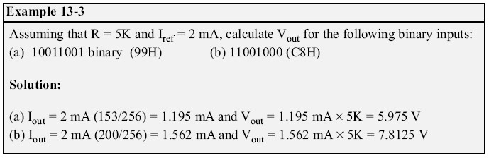
Project 4:Interfacing of 8051 with DAC
99 H = 153
C8 H = 200

Slide 26
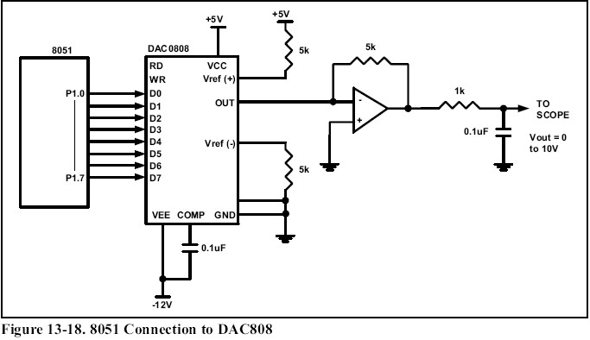
Project 4:Interfacing of 8051 with DAC

Slide 27

Project 4: Generate a Sine wave by Interfacing of 8051 with DAC
To generate a sine wave, we first need a table whose values represent the magnitude of the sine of angles between 0⁰ and 360⁰.
The values for the sine function vary from -1.0 to +1.0 for 0⁰ and 360⁰ angles.
Therefore, to achieve the full-scale 10 V output, we use the following equation.
V_{out} of DAC for various angles is calculated and shown:

Slide 28
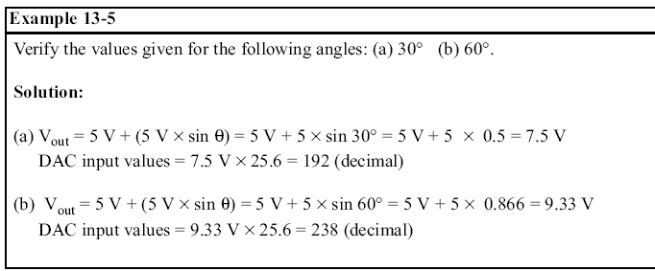
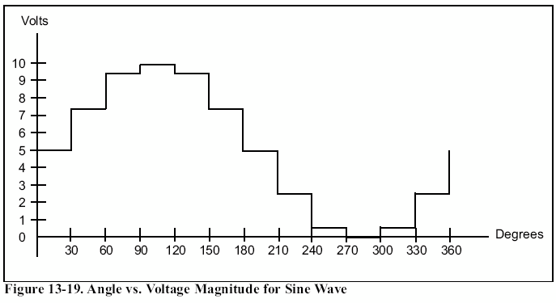

Slide 29
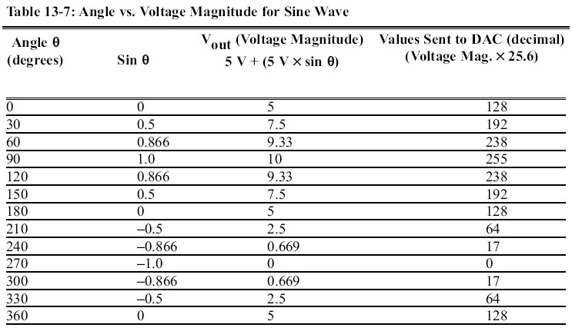

Slide 30
Project 4: Generate a Sine wave by Interfacing of 8051 with DAC
θ | Values sent to DAC (Decimal)
0 | 128
30 | 192
60 | 238
90 | 255
120 | 238
150 | 192
180 | 128
210 | 64
240 | 17
270 | 0
300 | 17
330 | 64
360 | 128
UP1: MOV DPTR, # TABLE
MOV R2, # COUNT
UP: CLR A
MOVC A,@A+DPTR
MOV P1, A
INC DPTR
DJNZ R2, UP
SJMP UP1
TABLE: DB 128, 192, 238, 255, 238, 192, 128, 64, 17, 0, 17, 64, 128

Slide 31

Project 5: Generate a Triangular wave by Interfacing of 8051 with DAC
MOV A, 00H
MOV R1,FFH
MOV R2,00H
UP1: MOV P1, A
INC A
CJNE R1, UP1
UP2: MOV P1, A
DEC A
CJNE R2, UP2
SJMP UP1
FF H
00 H

Slide 32
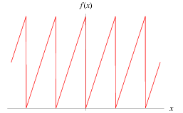
Project 5: Generate a Sawtooth wave by Interfacing of 8051 with DAC
MOV A, 00H
UP1: MOV P1, A
INC A
SJMP UP1
FFH
00H

Slide 33

Project 5: Generate a Triangular wave by Interfacing of 8051 with DAC
UP: MOV A, FFH
MOV P1, A
CALL DELAY
MOV A, 00H
MOV P1, A
CALL DELAY
SJMP UP
FFH
00H

